Slide 1
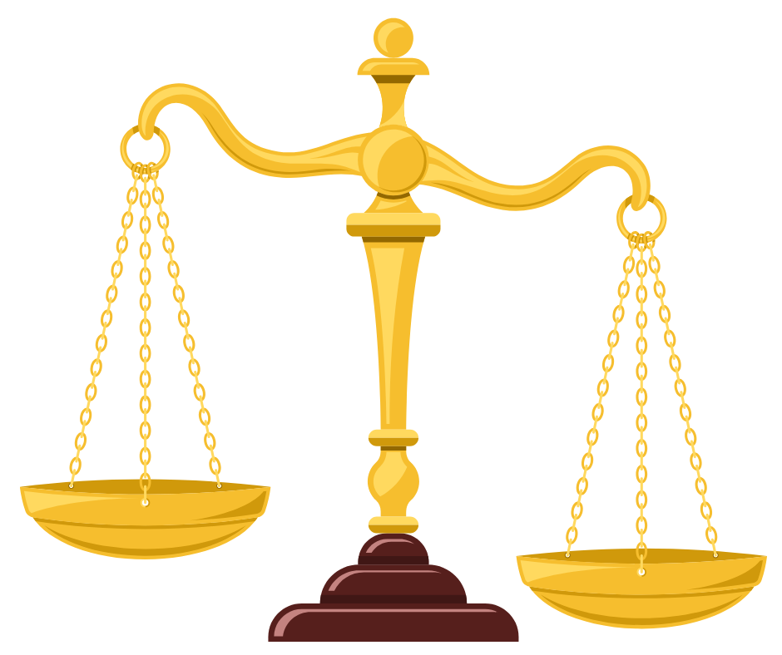
California v. Greenwood
A Supreme Court Case
© 2024 Teach Democracy, Los Angeles, CA All rights reserved.

Slide 2
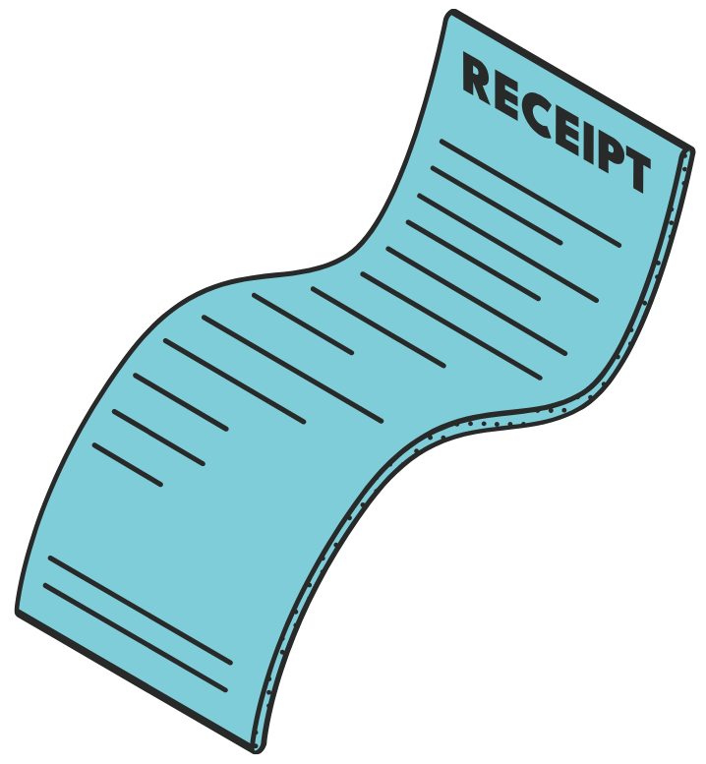
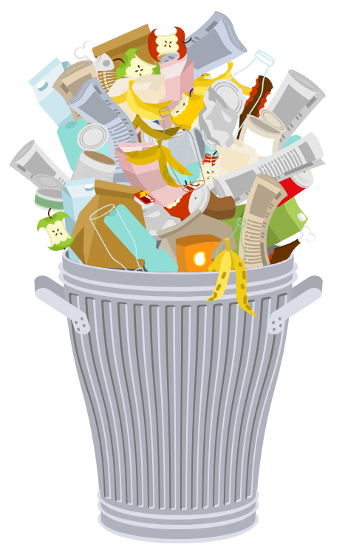

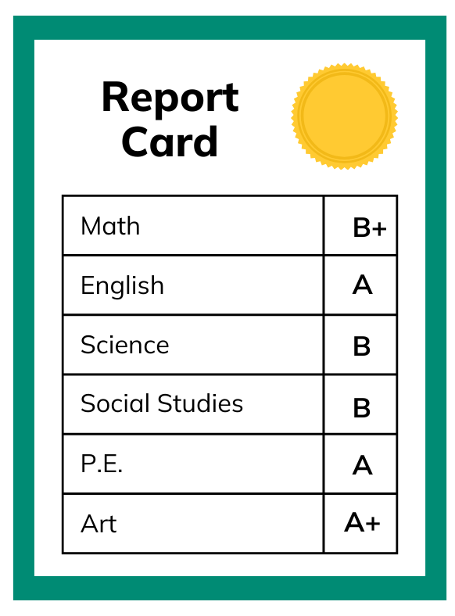



Are there things you throw away that you and your family would not like everyone to see?
How about . . .
Receipts
Notes home from teachers
Love letters
USB Drives
Photos
Underwear
Notes:
On slide: Are there things you throw…
Click 1: How about…
Click 2: Love letters + graphic.
Click 3: Receipts + graphic.
Click 4: Notes home… + graphic.
Click 5: Computer disks + graphic.
Click 6: Underwear + graphic.
Click 7: Photos + graphic.
1. Ask: What else might people throw away that they wouldn’t want others to see?
2. Explain: The case of California v. Greenwood was about trash and the issue of privacy.
Click to next slide.

Slide 3
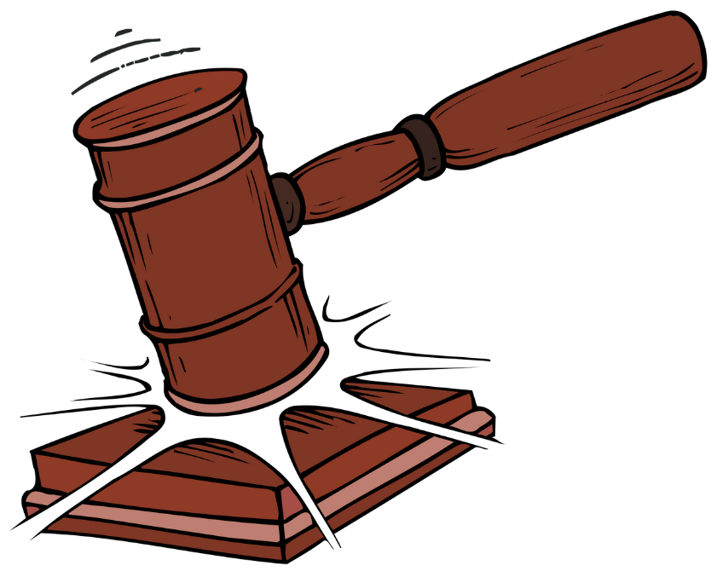
You are going to work on a case that went to the U.S. Supreme Court. The name of the case is California v. Greenwood.
Here are the facts:
In 1984, Billy Greenwood was arrested in California on felony narcotics charges. He was tried in Superior Court and convicted.
Guilty!
The police had collected most of the evidence against Greenwood from dark green plastic trash bags (the kind you can’t see through).
Notes:
On slide: You are going to…
Click 1: Here are the facts + In 1984… + graphic.
Click 2: The police had… + graphic.
Click to next slide.

Slide 4


Greenwood had left the bags out for the trash collector. They sat on the curb in front of his house.
The police did not have a search warrant. But they did get permission from the trash collector to look through Greenwood’s trash bags.
Notes:
On slide: Blue background.
Click 1: Greenwood had left… + truck drives in
Click 2: The police did not…
Click to next slide.

Slide 5
Under the Fourth Amendment, to conduct a search, police need...
“probable cause,” or a reason to suspect, that a person has committed a crime,
“consent,” or permission, from the person or property owner,
or a search warrant.
The police had none
of these.
Notes:
On slide: Under the Fourth Amendment…
Click 1: “probable cause,”…
Click 2: “consent,”…
Click 3: or a search warrant.
Click 4: The police had....
1. Ask:
What was Billy Greenwood convicted of?
Where did the police find most of the evidence?
Where were the trash bags located?
What do the police need to conduct a legal search?
What do you suppose happened next?
Click to next slide.

Slide 6


Greenwood’s lawyers appealed his conviction.
They argued that the police had no right to search the trash bags.
Therefore, the evidence from the trash bags should not have been admitted at the trial.
Notes:
On slide: All text and trash graphic.
Click 1: Access denied sound effect + graphic.
Click to next slide.

Slide 7
Both sides presented oral arguments and briefs to the appeals courts.
Attorneys for the state of California presented this argument:
Police did not conduct a “search” as defined by law. A search is a governmental intrusion into something in which a person has a reasonable expectation of privacy.
Greenwood had thrown away the evidence. He had no reasonable expectation of privacy in trash bags left on the curb for the trash collector.
Therefore, the police did not conduct a search.
Notes:
On slide: Both sides…
Attorneys for the state…
Click 1: Police did not…
Click 2: Greenwood had thrown…
Click 3: Therefore the police…
Click to next slide.

Slide 8
Greenwood’s lawyers presented this argument to the appeals court:
Greenwood did have a reasonable expectation of privacy of these bags.
Therefore, the police did conduct a search, which they had no right to do.
Notes:
On slide: Greenwood’s lawyers…
Click 1: Greenwood did have…
Click 2: Therefore the police…
Click to next slide.

Slide 9
The case went through the appeals process.
So the state of California appealed the case to the U.S. Supreme Court.
This court also ruled in favor of Greenwood.
Winner
The state then appealed to the California Supreme Court.
This court ruled in favor of Greenwood.
Winner
First, it went to the California Court of Appeals.
Notes:
On slide: The case went through…
Click 1: (from bottom) First, it went to the California Court of Appeals.+ graphic
Click 2: This court ruled in favor of Greenwood. + “winner” graphic.
Click 3: The state then appealed… + graphic.
Click 4: This court also ruled… + “winner” graphic.
Click 5: So the state of California… + graphic.
1. Ask:
What arguments did Greenwood’s attorneys make?
What arguments did the state of California make?
Which side won in the state appellate courts?
Who appealed the case to the U.S. Supreme Court?
Click to next slide.

Slide 10
You are going to take the case to the Supreme Court.
The U.S. Supreme Court had to decide these questions:
Was it a search?
Did Greenwood have a reasonable expectation that his trash would remain private?
Notes:
On slide: Blue background
Click 1: You are going to take…
Click 2: The U.S. Supreme Court..
Click 3: Was it a search? + Did Greenwood…
Ensure that students understand the questions.
Click to next slide.

Slide 11



You will take the roles of:
Justices of the U.S. Supreme Court.
Attorneys for the state of California.
Attorneys for Greenwood.
Notes:
On slide: You will take...
Click 1: Justices… + graphic.
Click 2: Attorneys for the state… + graphic.
Click 3: Attorneys for Greenwood. + graphic.
PAUSE to get students into groups.
1. Divide the class into three sections. Assign each section one of the roles:
Justices
Attorneys for California
Attorneys for Greenwood
2. Distribute Handout 1 to each student and explain that each group will work together to prepare to present the case of California v. Greenwood.
Click to next slide.

Slide 12
To prepare for the case...
Attorneys for Greenwood: Create arguments to convince the justices that Greenwood had a reasonable expectation of privacy. The trash bags should not have been searched.
Attorneys for the state of California: Create arguments that Greenwood had no reasonable expectation of privacy. The trash bags could be searched legally.
Justices of the U.S. Supreme Court: Create at least three questions to ask each side to help you determine the case.
Decide who will represent your group to perform the moot court.
Notes:
On slide: All text.
PAUSE to assign tasks:
1. As you present the instructions for each group, ask the students if they have questions.
2. Review the questions before the court and remind students that the case should focus on these issues.
3. Tell the students how much time they have to prepare their arguments and questions. Circulate among the groups and help them prepare.
When the groups are almost finished preparing, click to next slide.

Slide 13
Rules for the Oral Argument
1. Attorneys for the state of California will present first.
2. Attorneys for Greenwood will present second.
3. Justices will ask questions of both sides during the arguments.
The Justices’ Decision
1. After oral arguments, the justices meet and discuss the case.
2. Then they vote.
3. The justices will explain the reasons for the decision.
Notes:
On slide: All text.
PAUSE to provide final preparation time (3 minutes) and conduct moot courts.
1. After the students have had time to prepare, present the Rules for Oral Argument.
2. Explain that the state of California presents first because the state is the party appealing the case from the lower court.
3. Have each side choose two or three people to make its presentation. Give each side a set amount of time for the presentation, e.g. 2 minutes. Don’t count as part of the 2 minutes the time each takes to answer questions from judges.
3. After the oral arguments, ask the justices to discuss, out loud, their thoughts about the case. Explain that this is always done behind closed doors, but that you are interested in hearing their rationale.
4. Ask the justices to take a vote.
5. Ask the rest of the class if they agree or disagree with the decision. Ask students to give reasons why.
After the justices have decided, click to next slide.

Slide 14
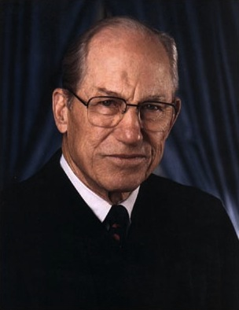
The Decision of the U.S. Supreme Court in
California v. Greenwood (1988)
The court found in favor of California.
Writing the opinion of the court, Justice Byron White said:
“. . . plastic garbage bags left . . . at the side of a public street are readily accessible to animals, children, scavengers, snoops, and other members of the public . . . . Moreover, [Greenwood] placed . . . . refuse for the express purpose of [giving] it to . . . the trash collector . . . . [Greenwood] could have no reasonable expectation of privacy in the . . . items . . . discarded.”
Notes:
On slide: The Decision…
Click 1: The court found… + decision.
1. Share the actual Supreme Court decision and dissent (next slide) with the class.

Slide 15
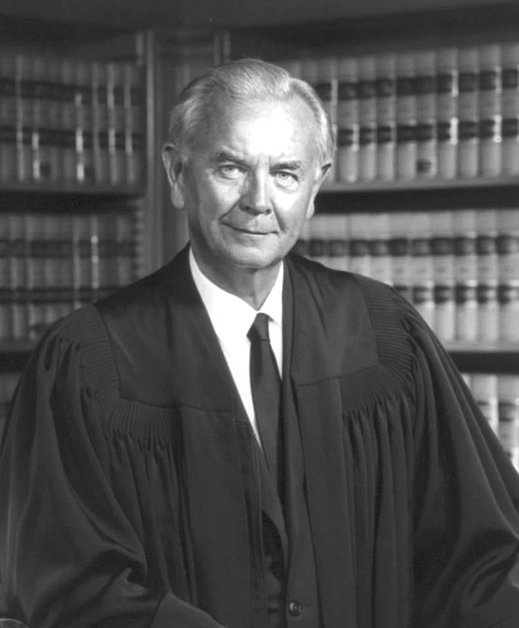
Writing in dissent, Justice William Brennan said:
“Society [should be prepared] to recognize as reasonable an individual’s expectation of privacy in the most private of personal effects sealed in an opaque container and disposed . . . [so as] to commingle it . . . with the trash of others. . . . The mere possibility that unwelcome meddlers might open and rummage through the containers does not negate the expectation of privacy in its contents any more than the possibility of a burglary negates the expectation of privacy in a home . . . .”
How do you think the case should have been decided?
Notes:
On slide: All text.
1. Compare the arguments the students made with the actual decision and dissent.
2. Congratulate the students on their participation.

Slide 16

Moot Court: California v. Greenwood
Designed by:
Marshall Croddy
Written by:
Keri Doggett & Bill Hayes
https://teachdemocracy.org/
Special thanks to Hon. John Kronstadt, member of Teach Democracy’s Board of Directors, for inspiration and input.
​
© 2024 Teach Democracy ​

